Slide 1
Explore the Impact of Location on Airbnb Price in New York City
IBM Data scientist certificate cAPSTONE PROJECT – tHE bATTLE OF NEIGHBORHOODS
BY tING LIU
October 2019

Slide 2
INTRODUCTION
Background: Airbnb Inc. is an online marketplace for arranging or offering lodging, primarily homestays, or tourism experiences. Airbnb listing prices are suggests by Airbnb and determined by hosts.
Problem: How to pricing/how to choose a place in budget
Interests: Tourist who wants to find an Airbnb for stay; Airbnb hosts; Airbnb to suggest a price.

Slide 3
Data
The New York City Airbnb Open Data (Kaggle.com)
48895 rows (listings)
16 variables in
Host
Location
Price
Reviews
Availability
Foursquare location data

Slide 4
Methodology
Exploratory Analysis
K-means clustering
Visualization
Foursquare location data

Slide 5
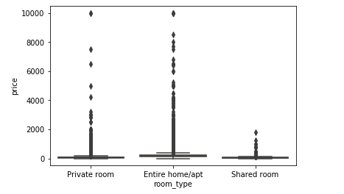
Exploratory Analysis I
Most expensive: Entire home/apt
Most diverse: Entire home/apt

Slide 6
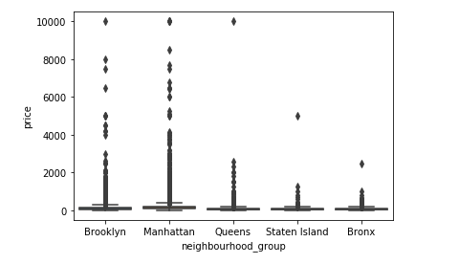
Exploratory Analysis II
Most expensive: Manhattan
Most diverse: Manhattan

Slide 7
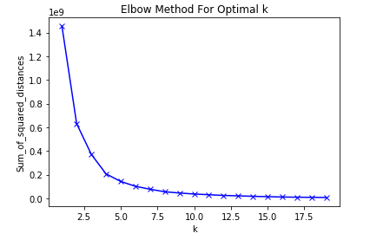
Cluster Analysis I
Elbow Method is used to find the optimal k.
Optimal k = 4

Slide 8
Cluster Analysis II
Cluster 0: Most listing, least expensive
Cluster 3: Least listing, most expensive

Slide 9
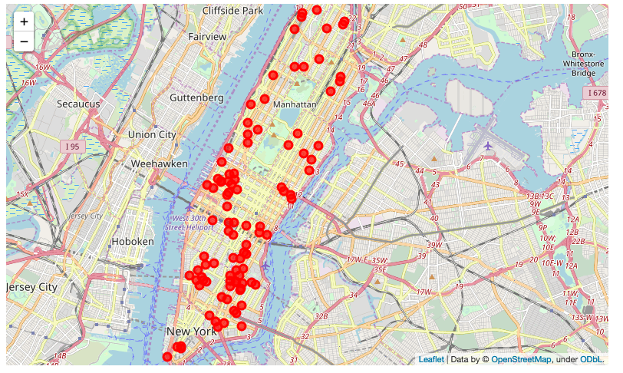
Cluster 0
12139 listings (100 show on the map)
$195 average listing price
Located in all neighborhoods

Slide 10
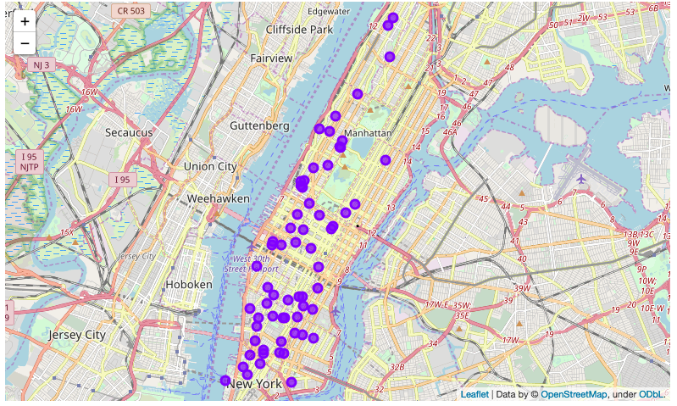
Cluster 1
64 listings
$1731 average listing price
Located in almost every neighborhood

Slide 11
Cluster 2
983 listings (100 show on the map)
$663 average listing price
Located in also all neighborhoods

Slide 12
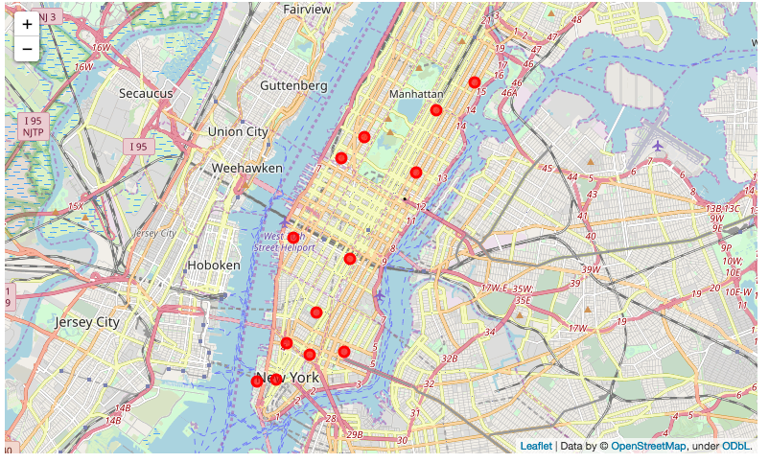
Cluster 3
13 listings
$5100 average listing price
Located in 10 neighborhoods. No concentrate.

Slide 13
Common Venues

Slide 14
Result
As the price decreases, the density of venues decreases as well. For example, for Cluster 3 listings, there are 51 Italian restaurants nearby. So for each listing, there are about 4 Italian restaurants nearby. But for Cluster 0 listings, same as Cluster 3, Italian restaurants are the 2nd most common venues, but the total number is 38. So for every listing, there are 3 Italian restaurants nearby.
Art Galleries are very common near Cluster 3 listings. For each Cluster 3 listing, there are more than 3 Art Galleries nearby. Also, Wine shops are common for Cluster 3 listings only. There are about 2 Wine shops near each Cluster 3 listing.
Gym/Fitness centers are common for Cluster 1,2 and 3. For the least expensive cluster – Cluster 0, you can find different restaurants around, but not so much fitness centers.
Clothing stores and Boutiques are only common near Cluster 1, which is the 2nd expensive cluster.

Slide 15
Conclusion
Airbnb prices differed from town to town, but in a town, such as Manhattan, the prices are not determined by the neighborhood, as expensive ones and affordable ones are mixed together.
In areas that Art Galleries, clothing stores and bouquets concentrated, the room prices are high.
In areas that with a lot of restaurants but no of few gym, the prices are low.
In the future: to add house/apt information

